Slide 1
Prepare for event

Slide 2
Kudopalooza Participation Requirements
Pre-Event Requirements: Provide key information: http://aka.ms/kudo4swag Pre-Event Preparation: Create community post as directed about the event*
During Event Requirements Present slide deck introducing attendees to the community Attendees register for the community; search for the event post previously created; kudo the post Organizer randomly chooses winners (minimum 3; up to 10% of total kudos rcvd; max 25) Organizer presents certificates Organizer posts winners' usernames in the original post
Post Event Requirements: Provide Information: # Actual Attendees Average Satisfaction score Community usernames of winners (up to 10% of attendees)
*This provides a post for your students to search for in the community to qualify for swag!

Slide 3
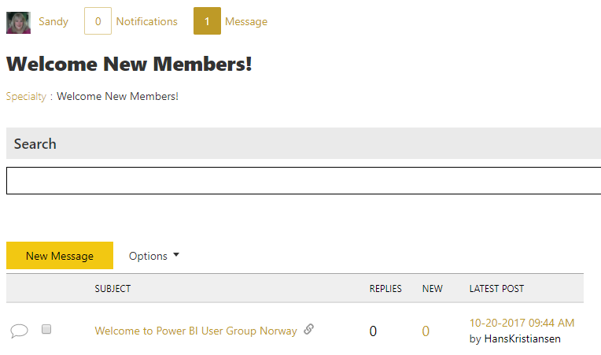
Prior to Event:
Prepare for student participation
Host or instructor signs into the Power BI Community
2. Navigate to: https://community.powerbi.com/t5/Instructor-Led-Training/bd-p/DIAD
3. Create a new* message with your event title and event date as the subject. Add the body of the message as a description of the event
3
*This provides a post for your students to search for in the community to qualify for swag!
Notes:
Create a post:
Title: <Name of Event> <Date> <Location>
Body: <About the event>

Slide 4
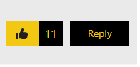
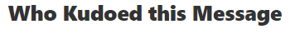
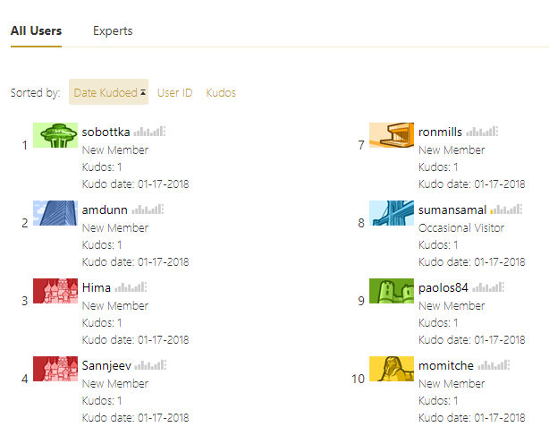
During Event:
1
Awarding Swag
2
1. During the "Kudopalooza Time" section of this deck (slides 14-15), have the students search for your post and then click the thumbs up button to kudo it.
2. On the post for this event, click on the kudo count to see who gave kudos to this post.
3. You will see a list of those students who kudoed the message, ideally kudo count = total # students).
4. Select random numbers to choose swag winners.
3
4

Slide 5

Be part of the community!
community@Microsoft.com

Slide 6
Overview

Slide 7





Business Applications Communities
Learn
Connect
Share
Inspire

Slide 8
What are communities?
Social networks where you can discuss ideas, share updates, and crowdsource answers from members around the globe.
This is a fast and smart way to connect and collaborate.
Peer to Peer Support
Communities let you:
Find answers faster: Tap into our communities to see who can answer your questions or to show you where to look.
Brainstorm with anyone in the community: Find inspiration to try something new from another community member
Learn from others: Participate and help build a pool of knowledge that’s accessible by members at any time!
Recognition
Product Showcase
Networking

Slide 9
Community
Learn • Connect • Share • Inspire
What’s in it for me?
How can I contribute?
Connect with peers and experts
Get answers to complex questions
Access to shared knowledge
Earn global recognition
Discover product use examples and videos
Engage in conversations
Write blog articles
Share photos and videos
Show product use examples
Become a moderator

Slide 10
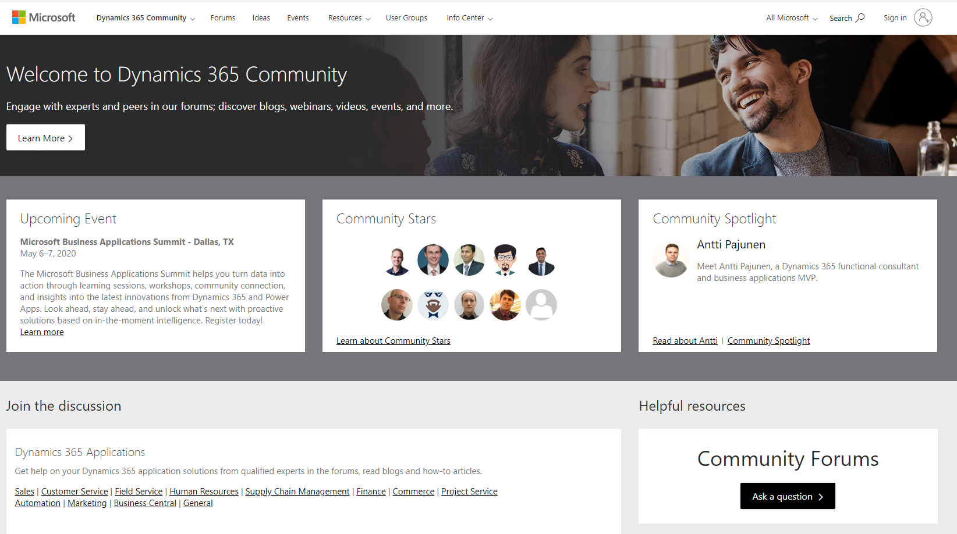
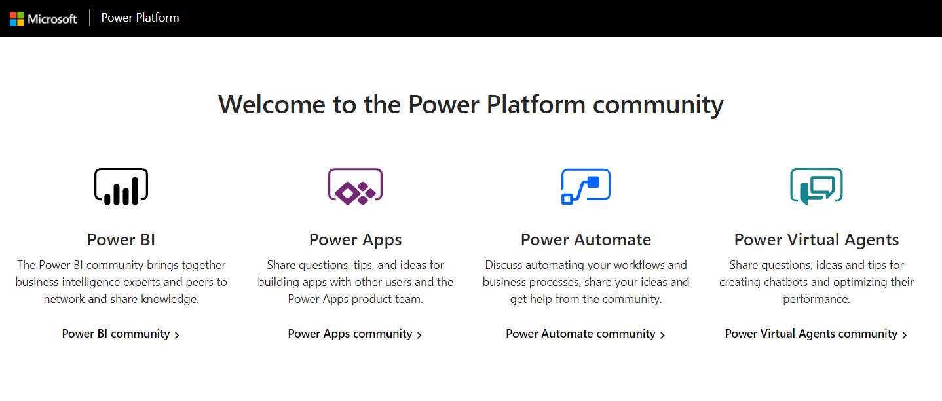
Community
Learn • Connect • Share • Inspire
How do I get started?
Community.Dynamics.com
Community.PowerPlatform.com

Slide 11
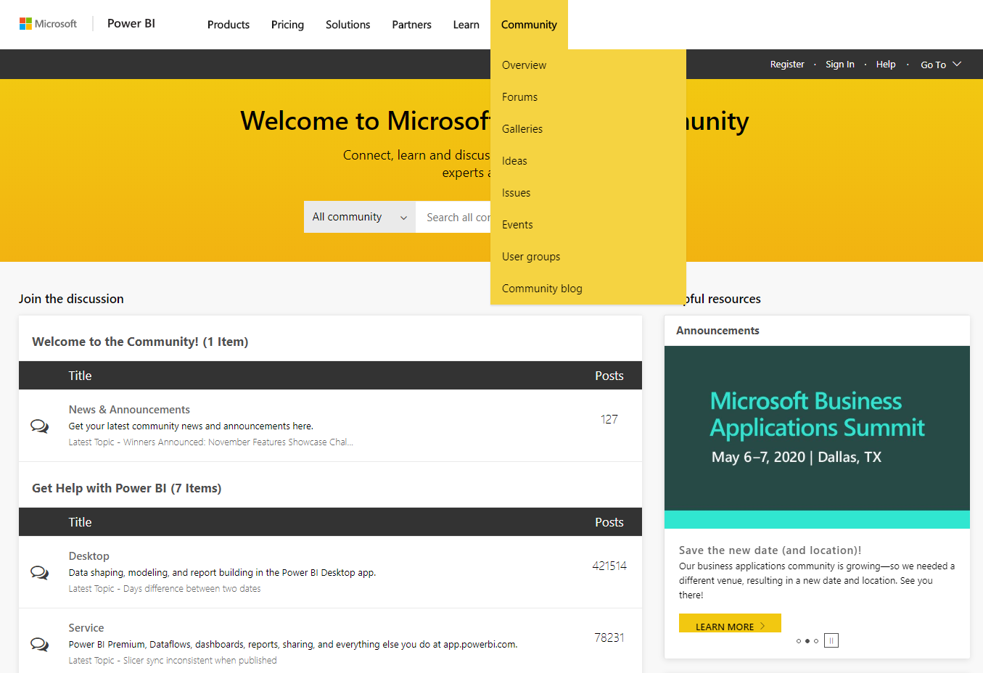
Power BI: What Makes Up Our Community?
What can I do:
Explore various opportunities:
Learn & share via discussion forums and galleries
Stay current with latest information and events
Connect with peers and experts

Slide 12
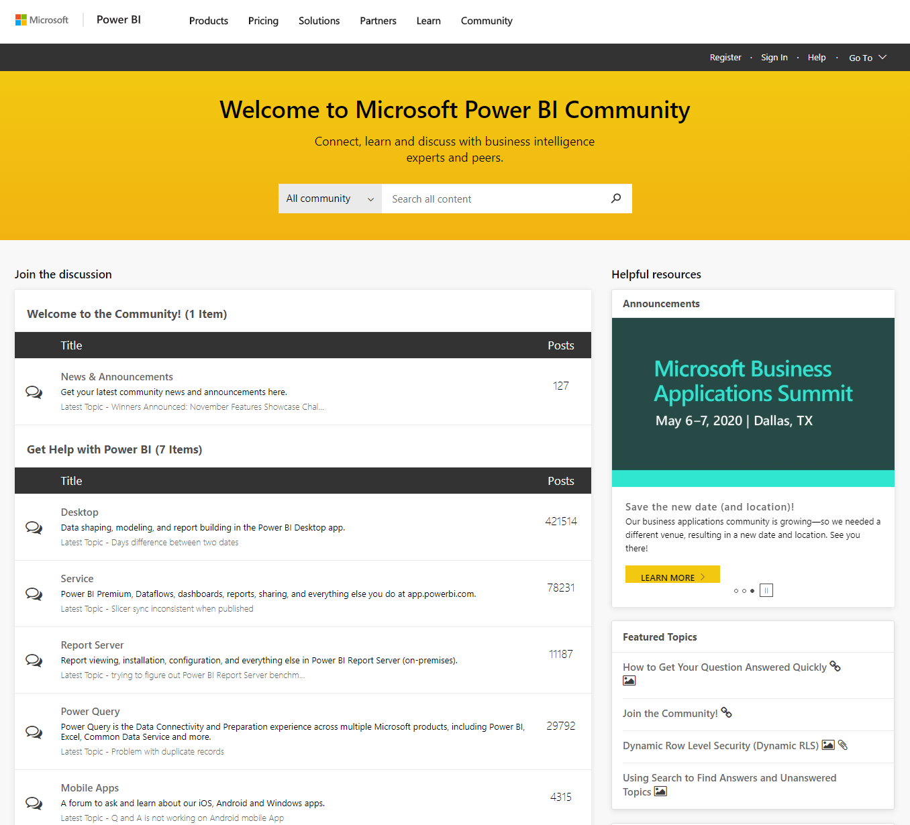
Community Highlights
Discussion Forums
Segmented by areas with:
Questions and discussion
High solution rates
What can I do:
Ask and answer questions
Join the discussions

Slide 13
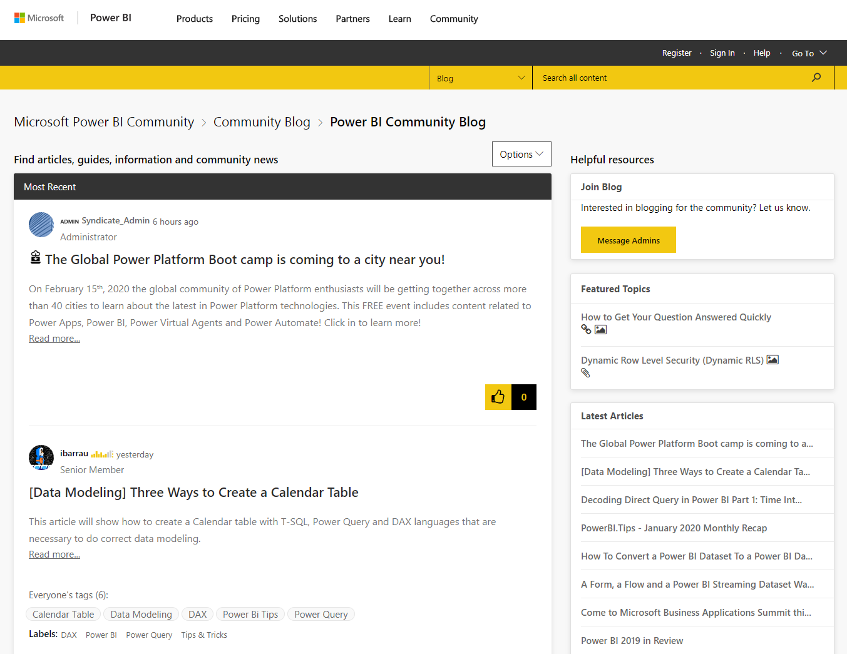
Community Highlights
Community Blogs
1,000+ blogs by experts, influencers and PMs
What can I do:
Keep current with insights from community peers
Create my own blog posts, grow my reputation

Slide 14
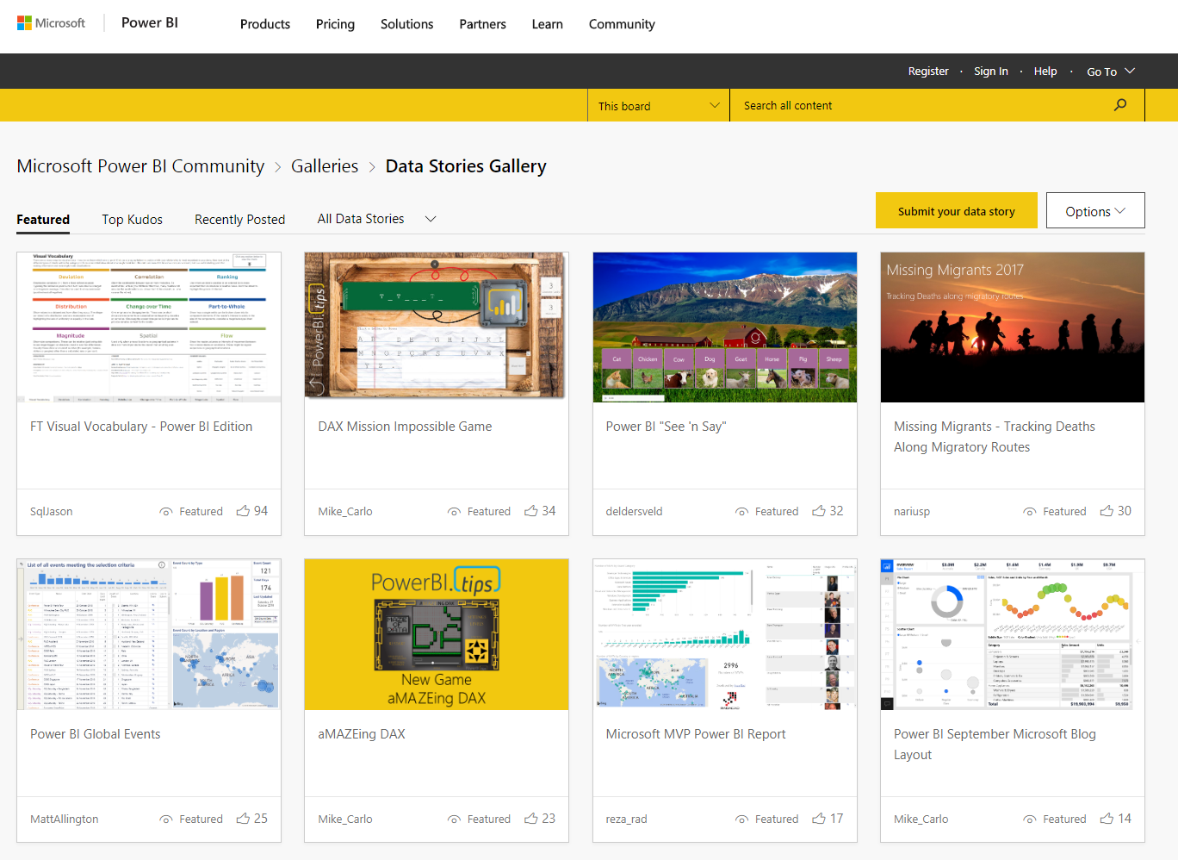
Community Highlights
Data Stories Gallery
Live examples of how people are using Power BI
What can I do:
Get ideas, get inspired
Share examples, inspire others

Slide 15
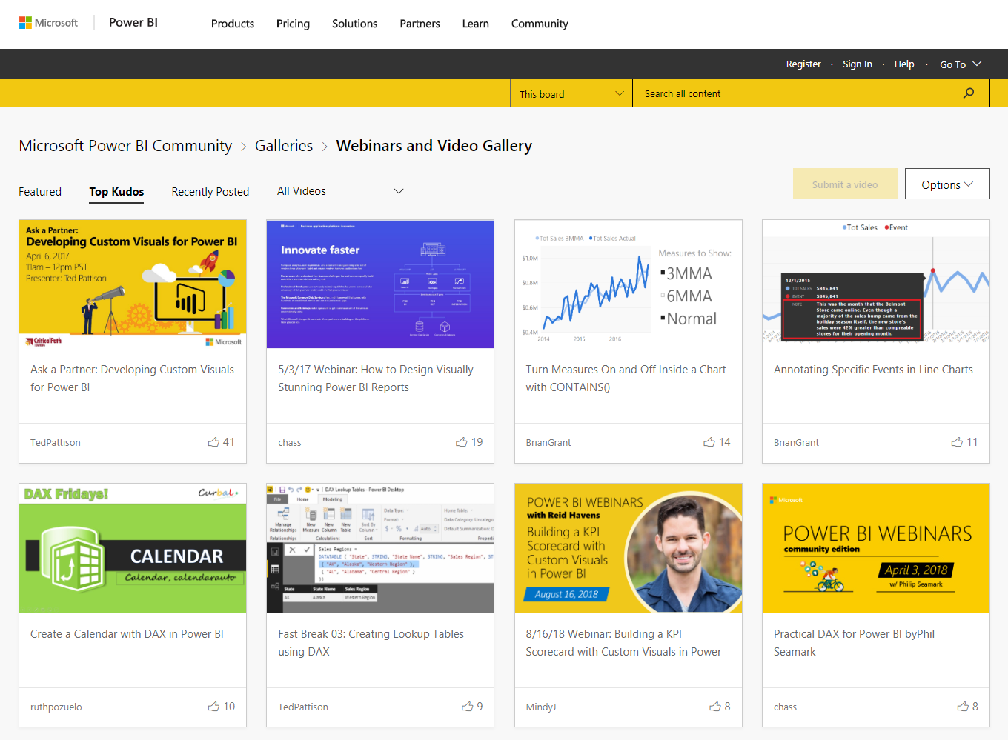
Community Highlights
Webinar / Video Gallery
Product/features webinars & videos
Free learning resource
What can I do:
Learn from peers & experts to grow my skills
Post my videos to share with peers and grow my reputation
Notes:
Mixed Reality App Forums just introduced
With Webinars, get real-world walk-throughs from MVPs, feature teams, and field teams of how to use capabilities, services, and features of Dynamics 365.

Slide 16
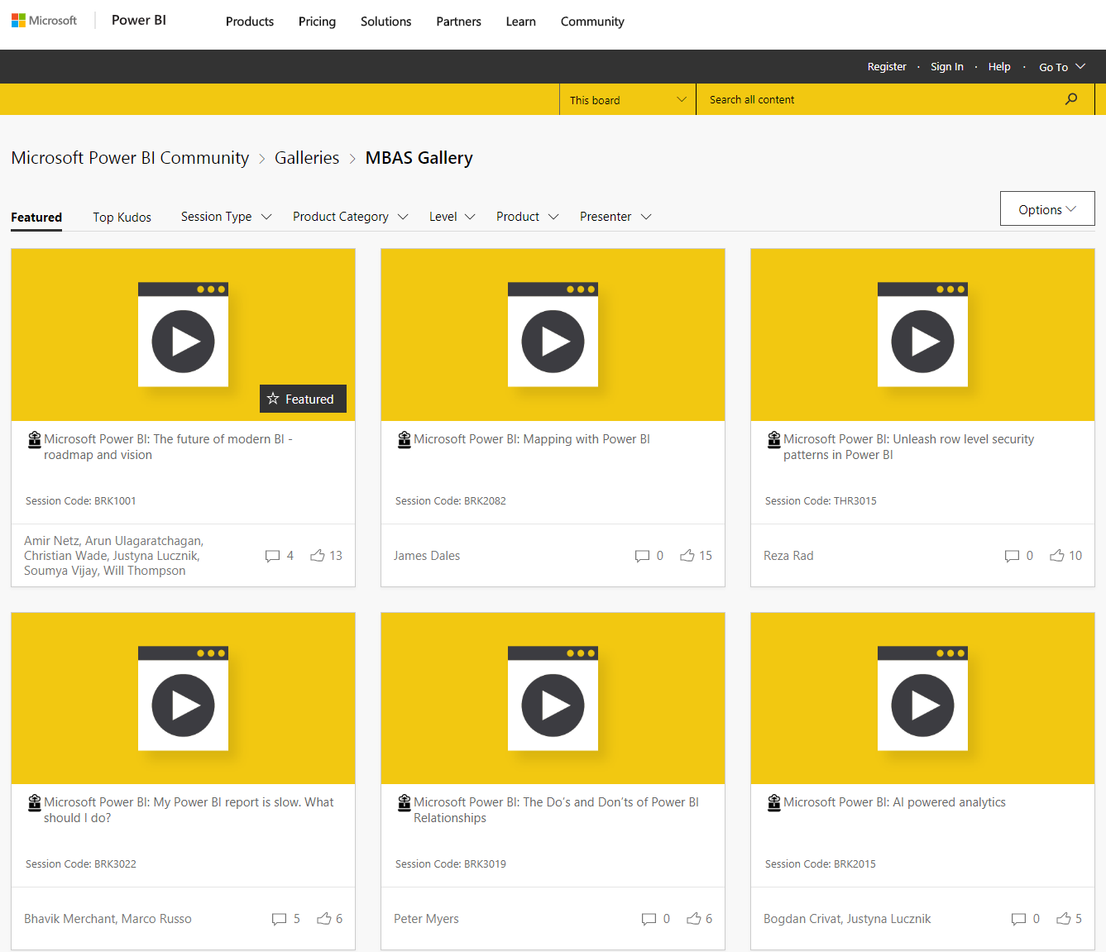
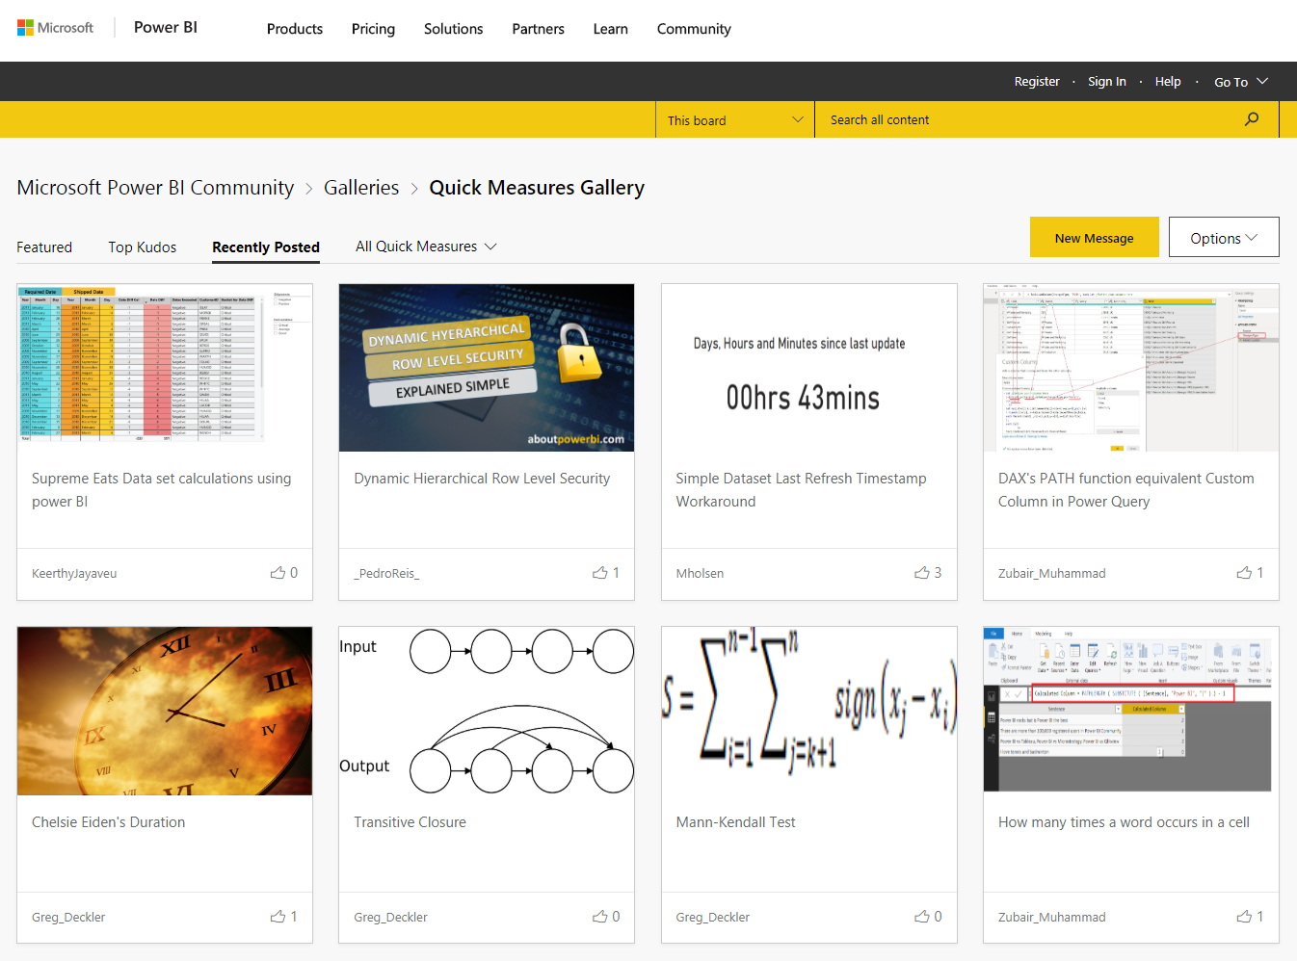
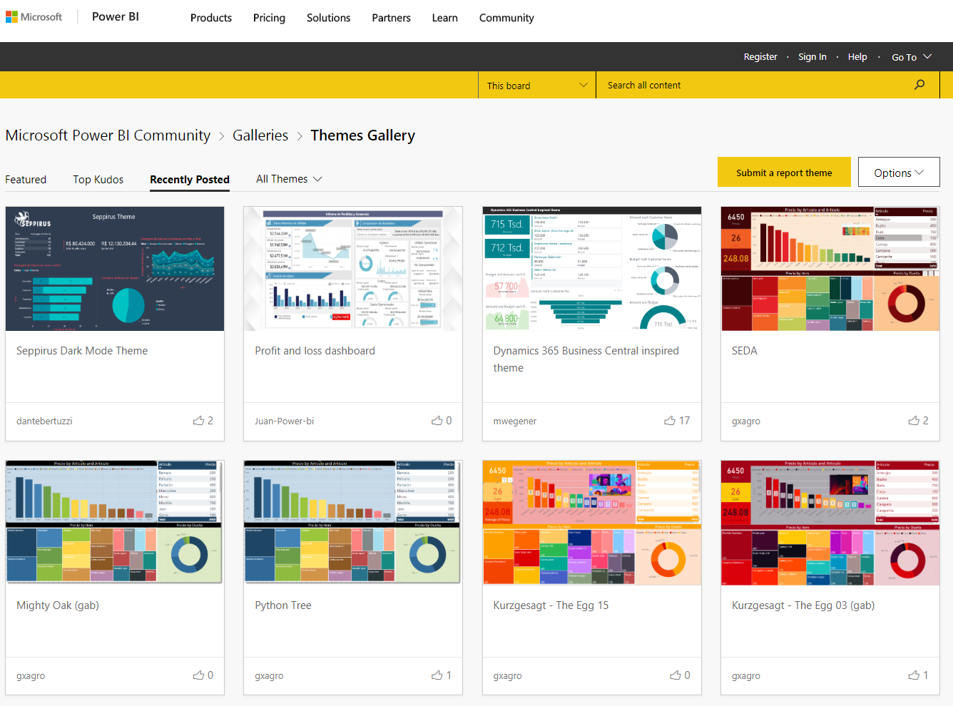
Community Highlights
More Galleries
MBAS Gallery – On Demand sessions from the 2019 Microsoft Business Application Summit
Quick Measures Gallery – Share and download advanced DAX snippets
Themes Gallery – showcase of stunning themes
And MORE!
What can I do:
Be inspired by examples shared
Share examples, inspire others

Slide 17
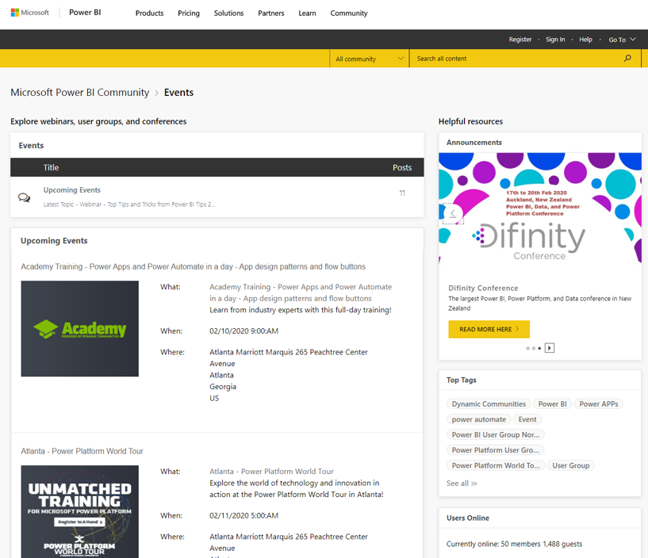
Community Highlights
Events
Community and partner events
What can I do:
Keep current on what’s happening around the community, both virtual and in-person
Promote events

Slide 18
Why should I join?
Connection
News
Fun
Connect with engineers and Microsoft employees.
Gain expert insight and feedback on a topic or provide suggestions on improving the product.
Member-exclusive events, such as the Ask Microsoft Anything (AMA) hour gives users the opportunity to ask questions and share feedback directly with the product team.
Get exclusive access and product news.
The community offers exclusive, members-only resources on how to use the product.
The community blog is a great resource to learn more about the latest news and trends!
Engage in fun, rewarding ways.
Want a chance to win prizes and earn exclusive perks? Participate in contests to discover fun and rewarding ways to engage with the community!

Slide 19
How can I join?
Joining a community is easy!
And you can join them all!
Select the community
Community.Dynamics.com
Community.PowerPlatform.com
Click Register / Sign In
Fill out form; select username
Click Sign In to enter the community.

Slide 20



Key Community Skills
Search
Kudo
Comment

Slide 21
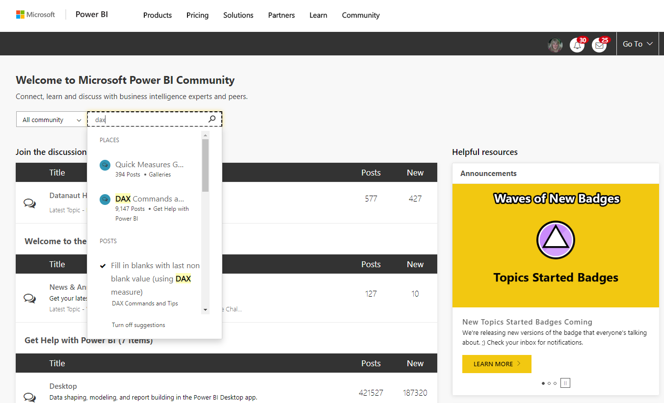
SEARCH for content
Find the Search box
Enter your search words
Choose an option from the drop-down list

Slide 22
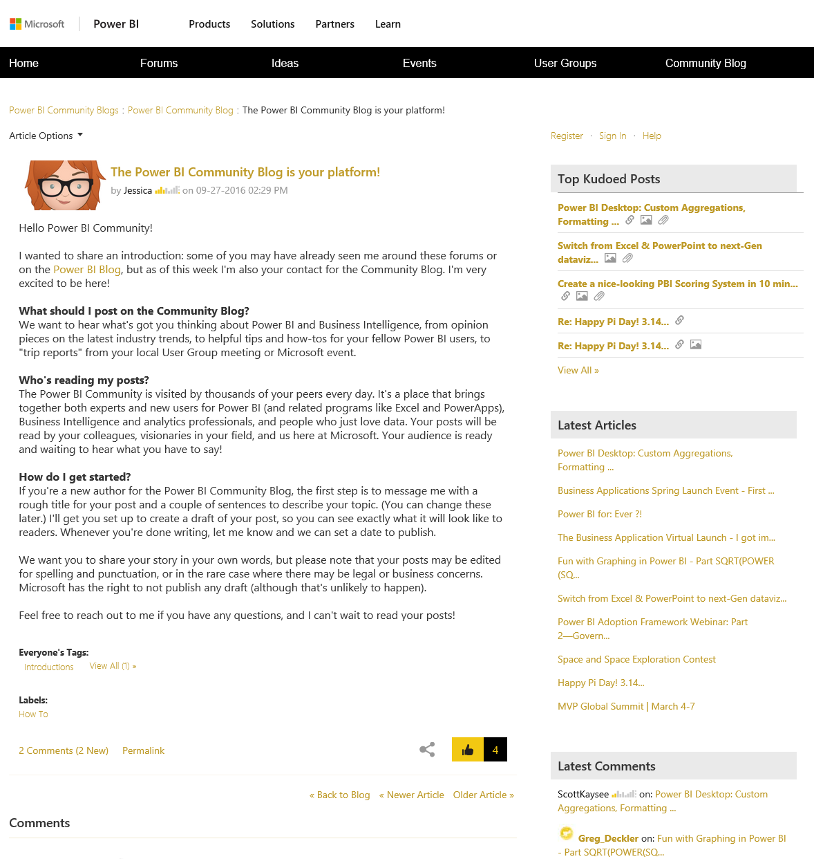
KUDO a post
If you like a post, let the author know
Scroll to the bottom of the post
Click the thumbs up button

Slide 23
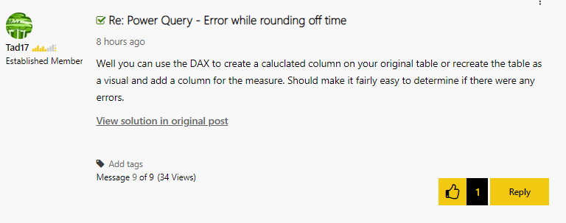
Comment
If you want to reply or comment, scroll to the Comment box
Add your comment
Click Post Your Comment

Slide 24
Kudopalooza Time!

Slide 25
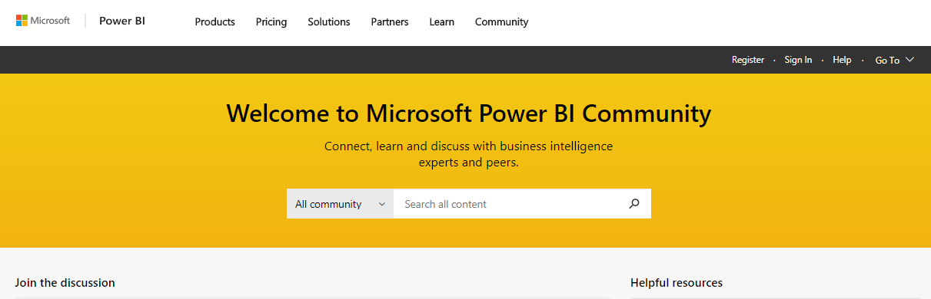
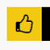
Kudopalooza for SWAG
Navigate to the community:
2. Click Register / Sign In*
3. Search for your event name
4. Click on the post for this event to open it
5. Kudo the post (click the thumbs up) for a chance to win a prize
Community.PowerPlatform.com
1
2
3
*You must Register and sign in to join the fun!

Slide 26

Kudopalooza Winners are…
Notes:
Announce the winners

Slide 27
community@microsoft.com

Slide 28


